Slide 1
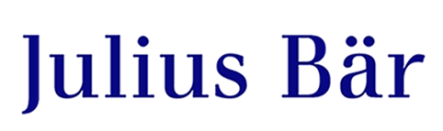
PYC Predict your client
Max, Lorenz, Janosch, Tamas creativity_is_all_you_need

Slide 2

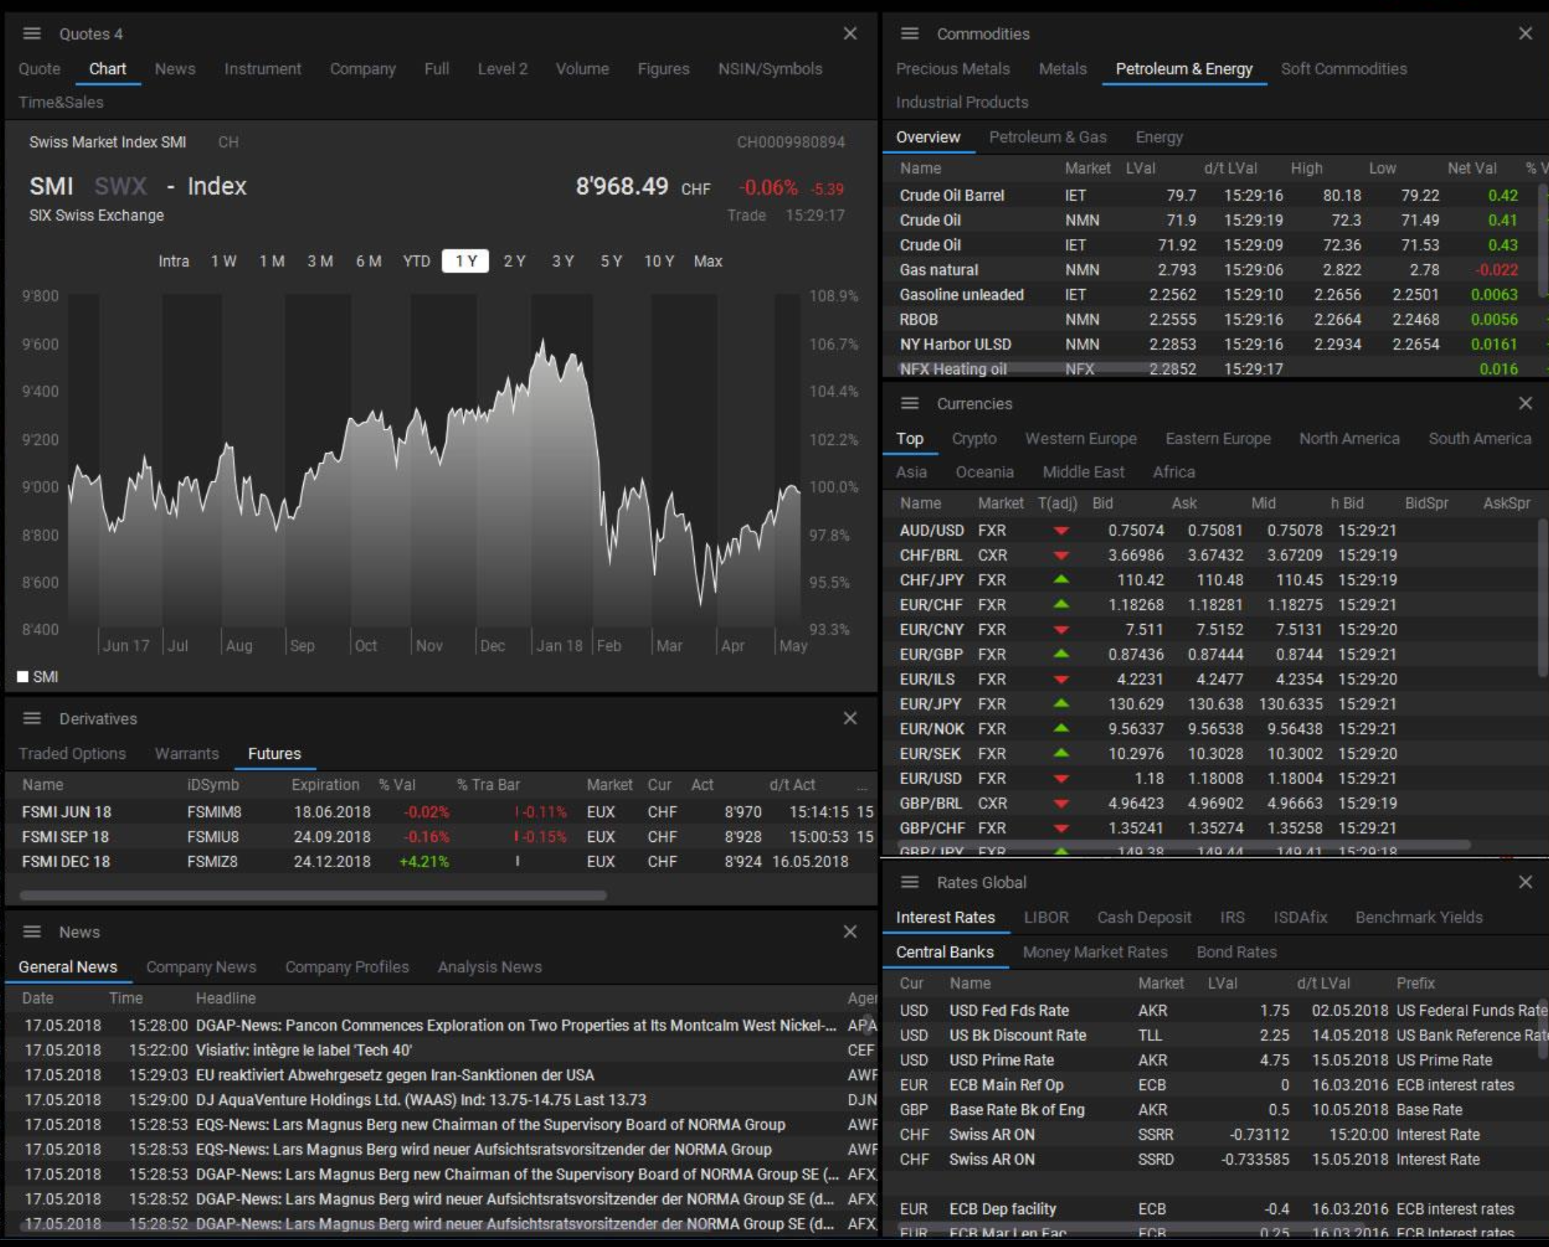
PYC - Predict your client
Imagine you’re an investment banker at Julius Bär.
To you, a new client in the beginning means this:
Would you be enthusiastic about getting new clients?

Slide 3
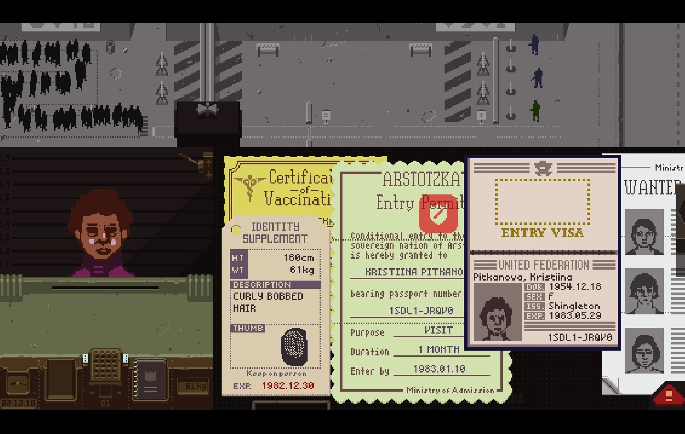
PYC - Predict your client
It is not your fault.
Your job is not easy.
It does not have to be this way.

Slide 4
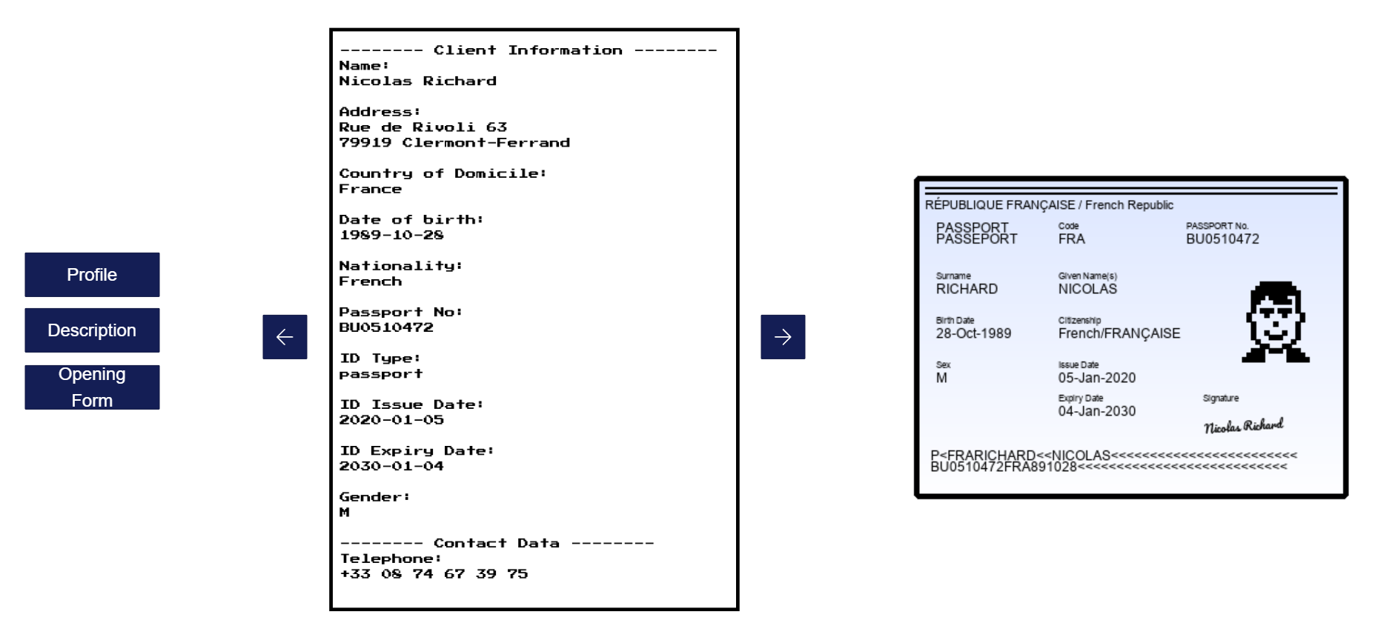
It is not their fault.
Their job is not easy.
PYC - Predict your client
It does not have to be this way.

Slide 5
It does not have to be this way.

Slide 6
Wolf of Paradeplatz
Tamas, Ian, Janosch, Rui
It does not have to be this way.

Slide 7
PYC - Predict your client

Slide 8
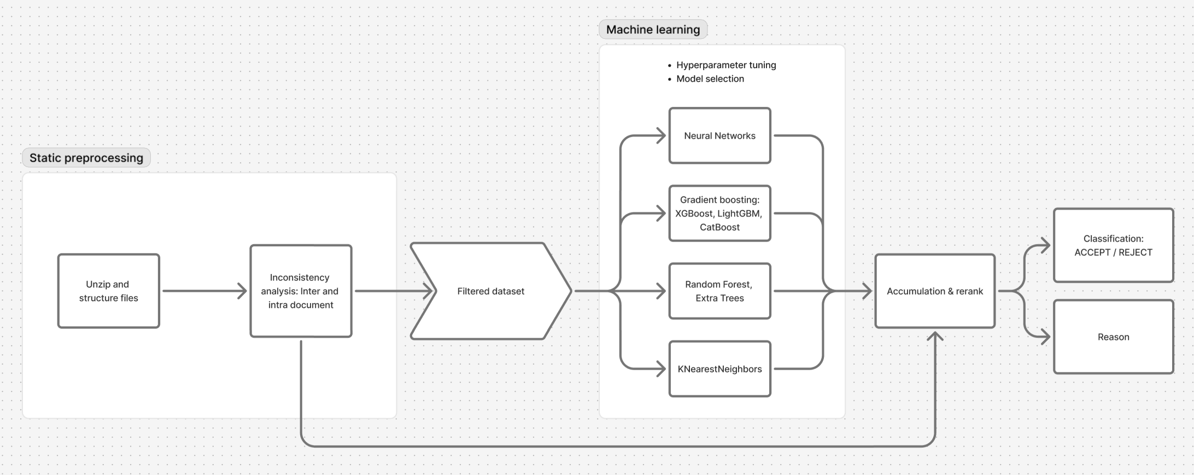
PYC - Predict your client
Composite solution pipeline for automated client evaluation

Slide 9
PYC - Predict your client
Our static preprocessing screens client documents for inconsistencies, provides explainability at each stage
50%
of rejected clients in dataset – without false positives!

Slide 10


PYC - Predict your client
What makes our solution perfect for Julius Bär?
Administrative burden
Low risk exposure
Less paperwork and faster processing
Elimination of human errors
Client experience
Immediate, accurate feedback
➔ happier clients

Slide 11
PYC - Predict your client
Our results:
88.75%
93.25%
Average accuracy on test data
Average accuracy on full dataset

Slide 12
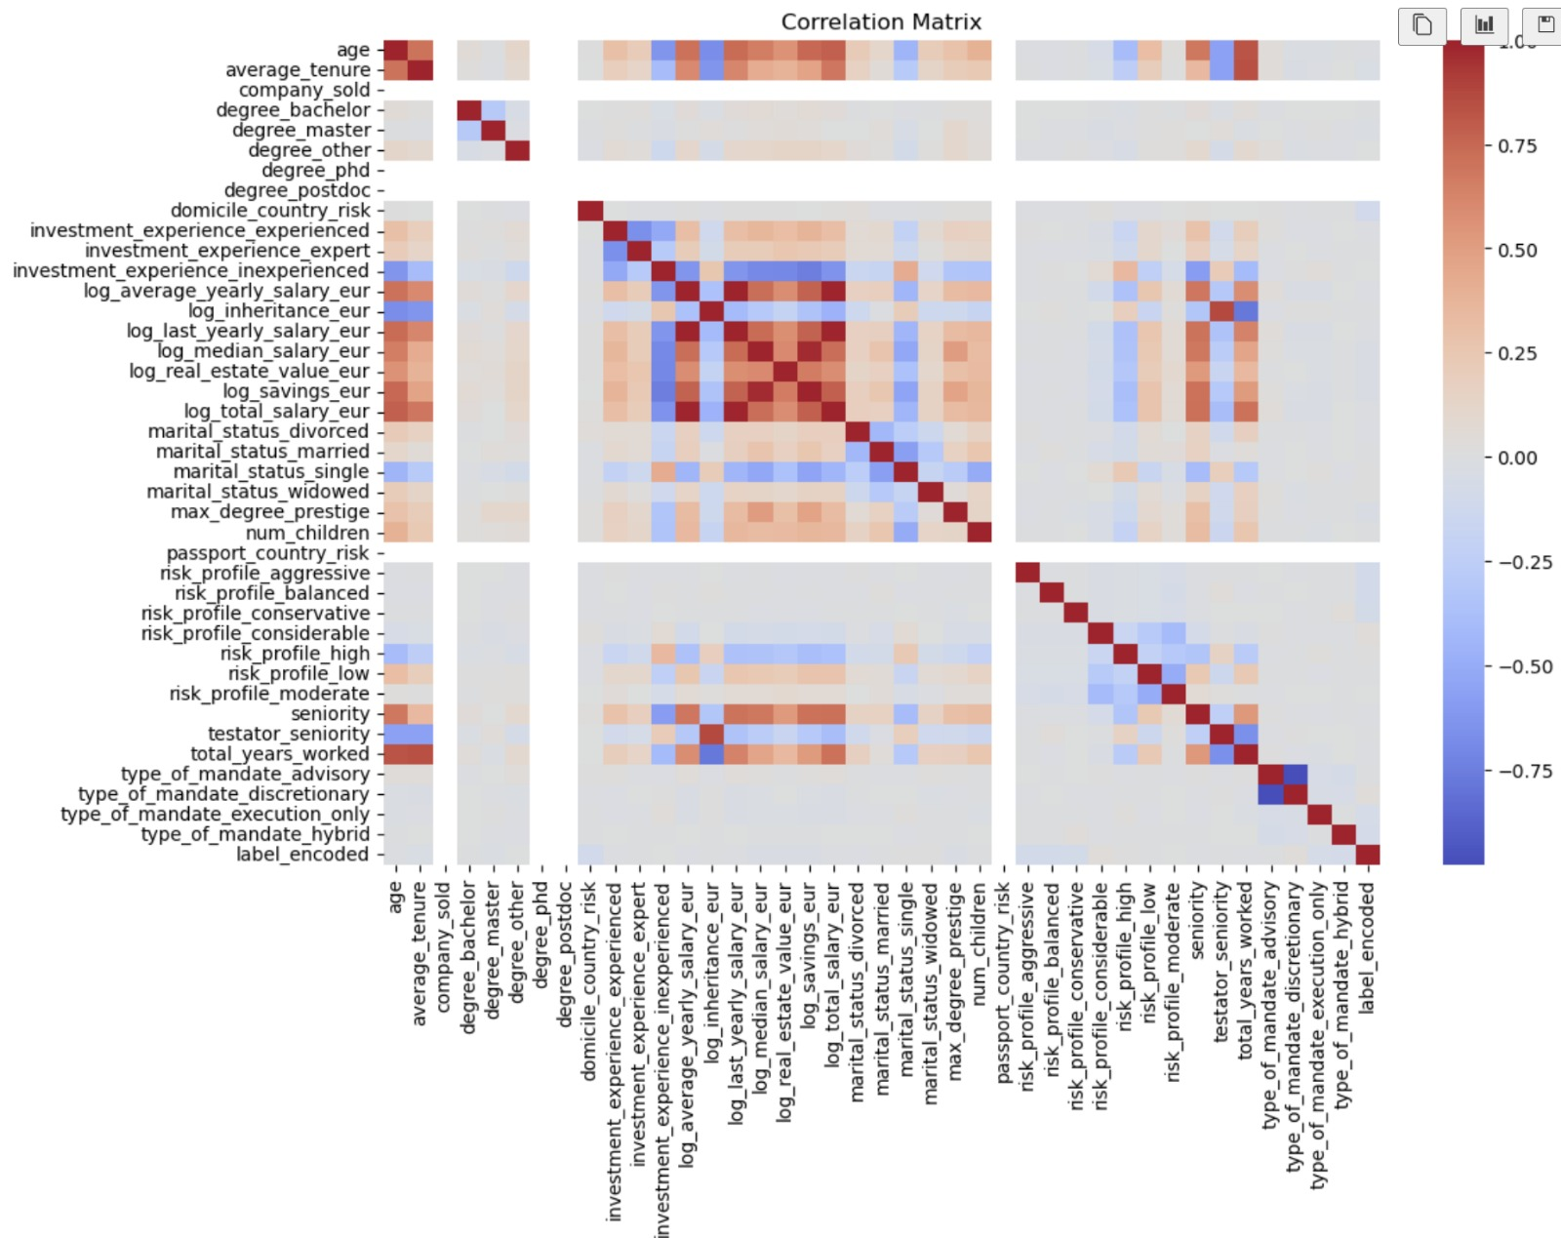
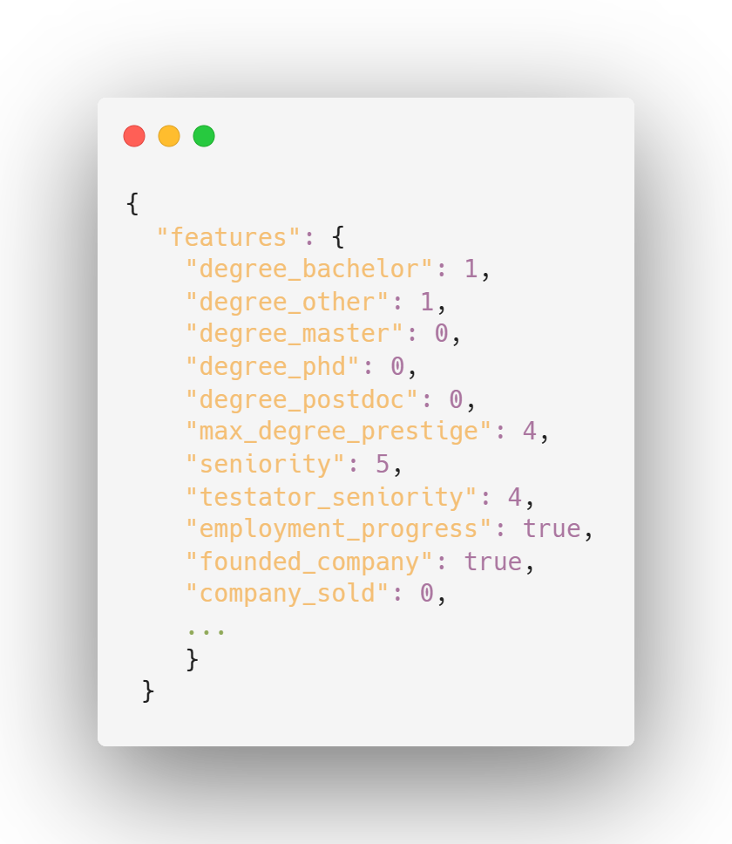
PYC - Predict your client
Challenges:
Feature extraction via Openai gpt-4o-mini and structured generation
➔ Low feature correlation

Slide 13
PYC - Predict your client
Future improvements:
Further feature engineering and dimensionality reduction
Integration as API endpoint
Frontend UI for drag-and-drop functionality
It does not have to be this way.

Slide 14



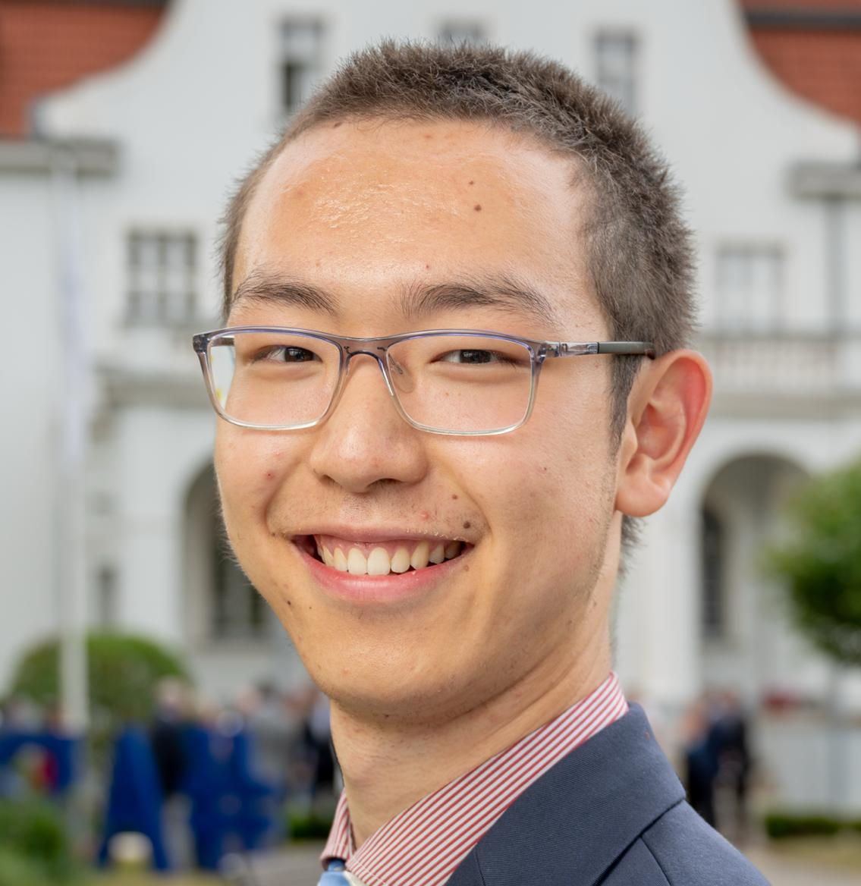
PYC - Predict your client
Our Team
Tamas Nemes
Janosch Moor
Lorenz Weingart
Max Liu
feature engineering, llm-parsing, presentation
structuring, preprocessing, data-submission
feature-engeneering, preprocessing, presentation
ML-architectures, hyper-parametertuning
It does not have to be this way.

Slide 15
PYC - Predict your client
Let us reshape client onboarding experiences –
for bankers and clients alike.
It does not have to be this way.

